Slide 1
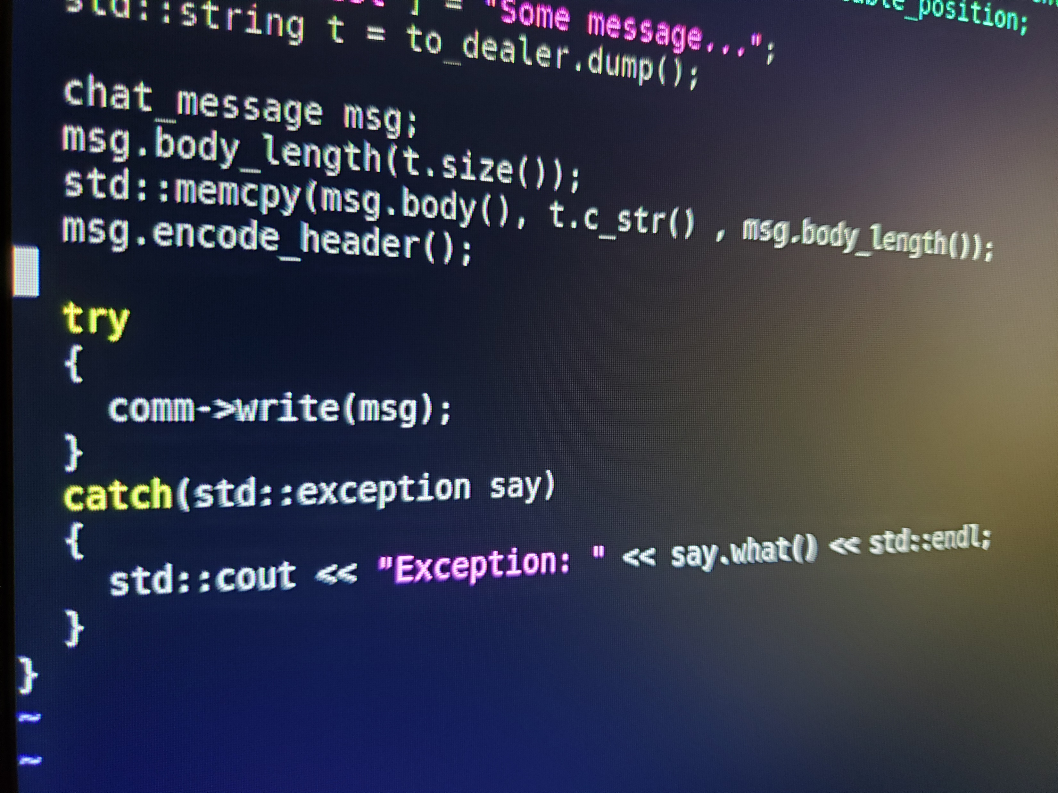
Project Summary Report
Group 002-5
Team members
Randall Ferree
Robbie Frazier
Shishir Acharya

Slide 4
Group Dynamics
Communication via GroupMe and GitHub
Communication suffered after COVID-19
Moderate balance of skills
Occasional disagreements about where code should be headed
Changed the code from other member for better optimization

Slide 5
Quality and Completeness
The project is almost complete. It has some issues in run time which we are working on to fix it. Talking about the quality, it is only moderate since the code can be cleaned up a lot.

Slide 6
Randall Ferree
Interesting parts: working with others who come from different engineering backgrounds and perspectives.
Difficult parts: also the most difficult parts is working with others who come from those different perspectives. Sometimes we provide each other with good points and other times we can’t see eye to eye on things on what we believe is the best path.
Skills: better communication, negotiating, and planning

Slide 7
Robbie Frazier
Most Interesting: It was interesting to see how different students viewed and approached problems.
Most Difficult: A seemingly small project quickly developed into a significant effort. This was my first exposure to a client/server application, and the communication between the two was significantly more challenging that I anticipated.
Skills Learned: The project helped me understand the importance of well-defined requirements and design.

Slide 8
Shishir Acharya
Interesting parts: Working with other team members from whom we can learn a lot, putting different ideas together and producing the optimal solution. Sharing knowledge was the most interesting part, my other team members were like a guardian to me who have guided my OOP skills.
Difficult parts: We all had different ideas how to proceed further, and it’s difficult to comply with other’s ideas dumping your own. However, that’s the most important part we have to learn while working on a team. We should always choose the better, optimal and the efficient way to solve our problems.
Skills: Pushing and pulling from github, built a connection between client and server, json library, GTK, better communication, presenting ideas and overall OOP skills.

Slide 9
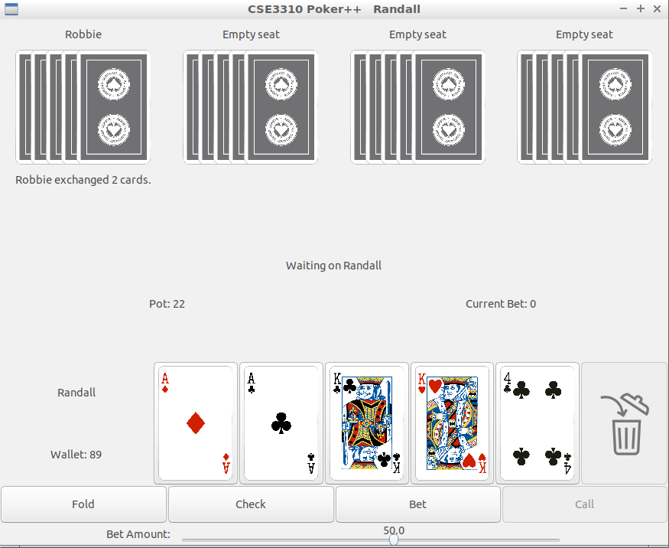
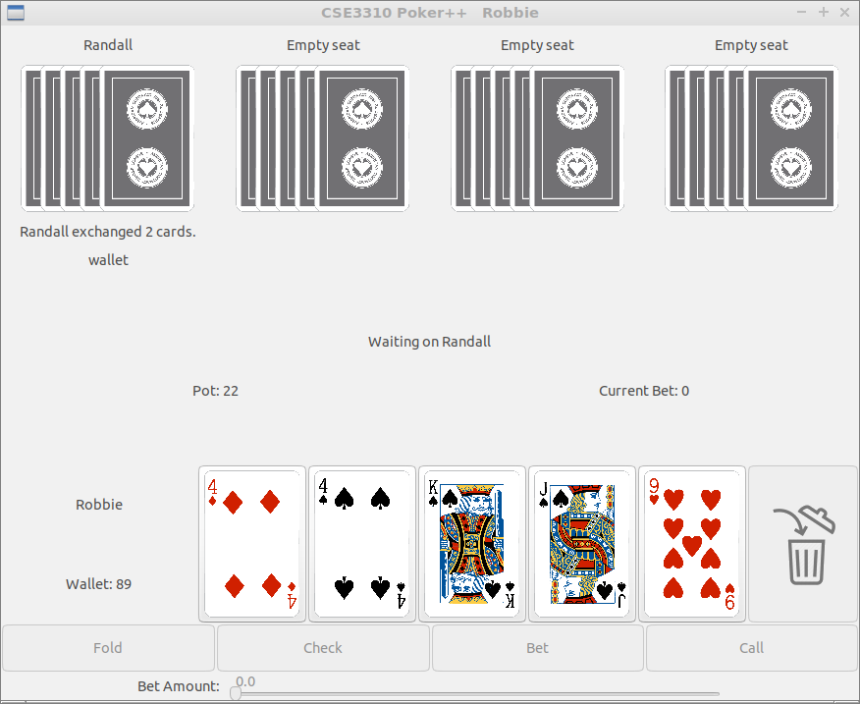
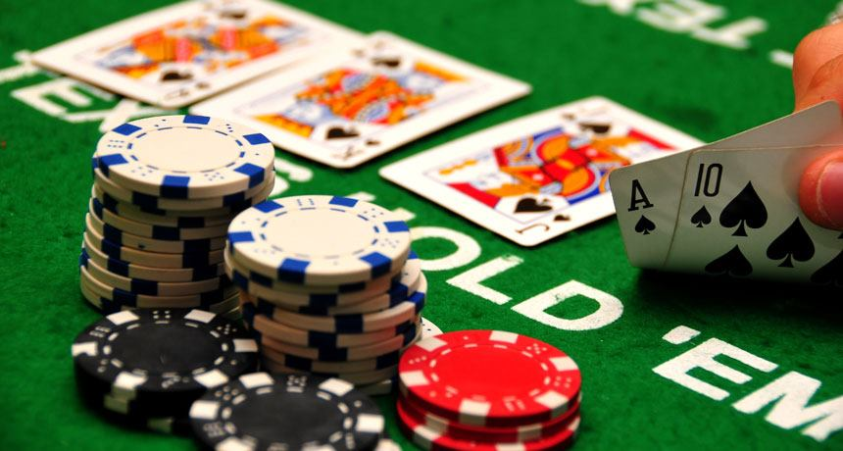
Gameplay with two separate clients

